Slide 1
Advanced Github Topics
InstructorS –
Zach martin & Chris Daniels

Slide 2
Initial resources and Introductions
https://github.zach-martin.com/advanced.html
A quick introduction –
Zach Martin
14 years IT experience
4 years professional software development experience
Father to a seven-month-old baby girl
Chris Daniels
Heads up the 1819 Initiative at UC
7 years professional software development experience
Father to a five-month-old baby boy

Slide 3
Presentation Objectives
Advanced Git Tactics
Rebase – What it is and when to use it
Forking vs. Cloning
Tags – $20 in my pocket?
Advanced GitHub Features
Actions and Workflows to build a CI/CD Pipeline
Secrets and how to use them
Pull Request Management
Issue Tracking and Projects

Slide 4
Rebasing vs. Merging
Merging
Explicitly define what stays and what goes
A new commit with these specifications is created
Rebasing
“Replay” one branch at the end of another
Cleaner tree with no additional commit

Slide 5
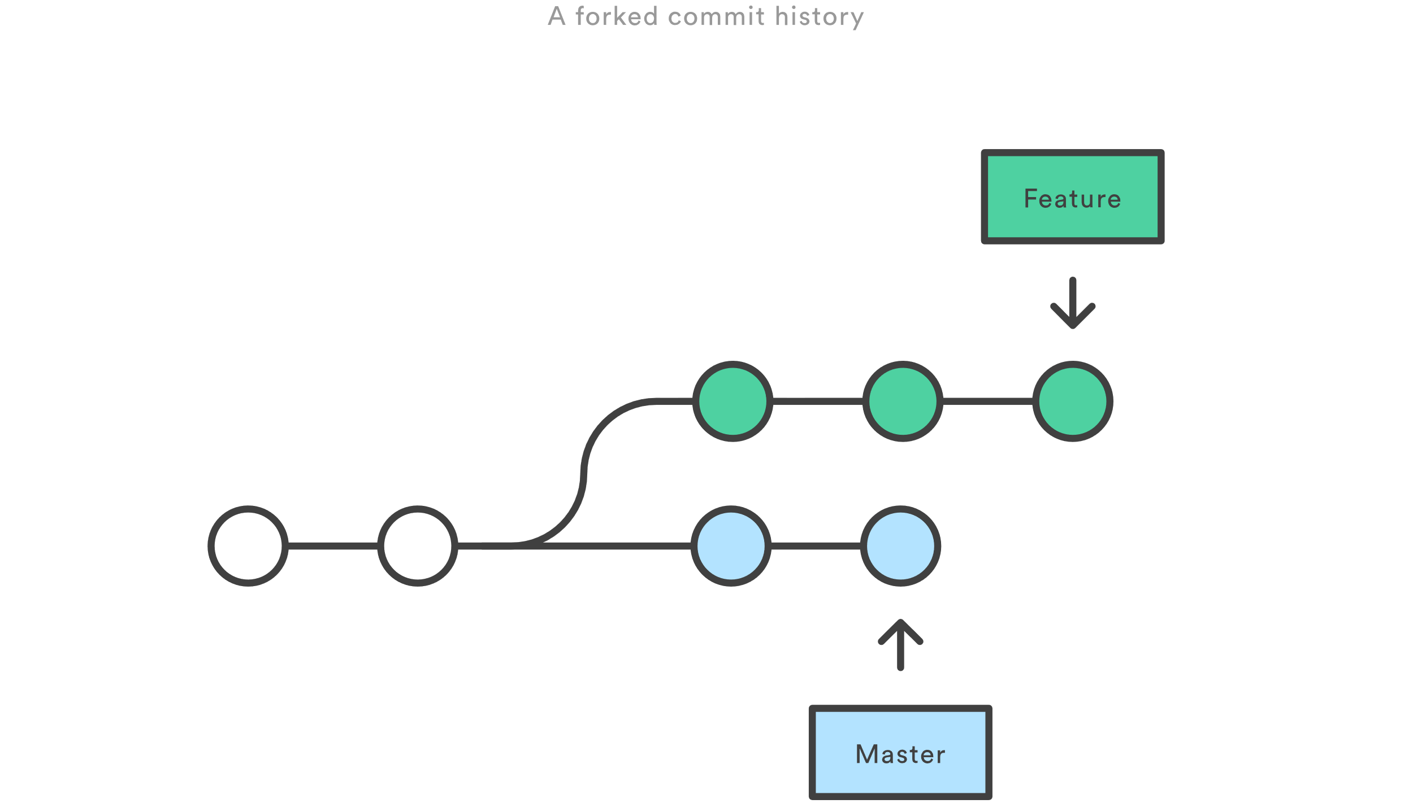
Rebase workflow

Slide 6
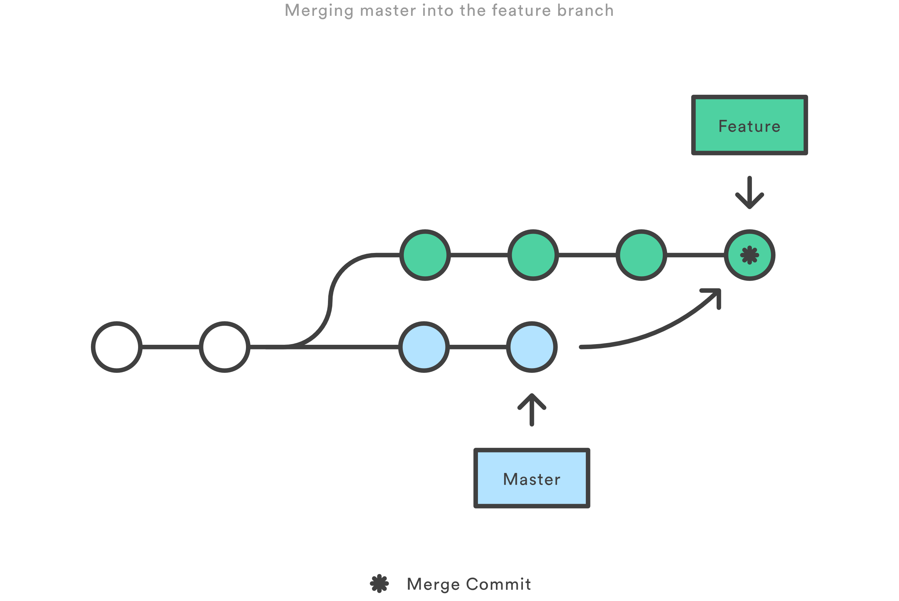
Rebase workflow (Cont.)

Slide 7
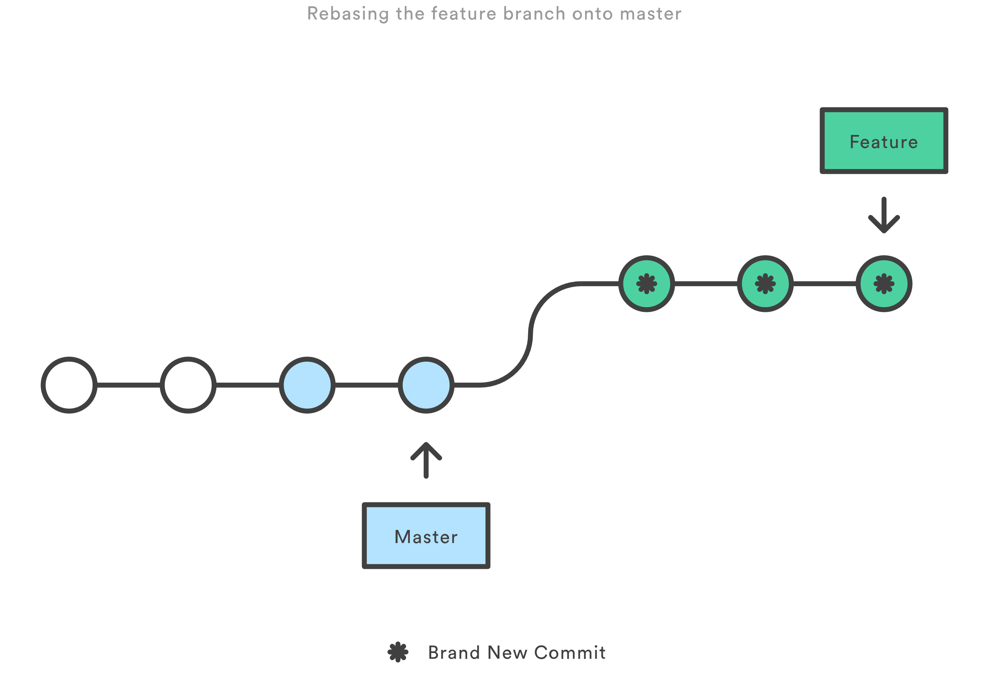
Rebase workflow (Cont.)

Slide 8
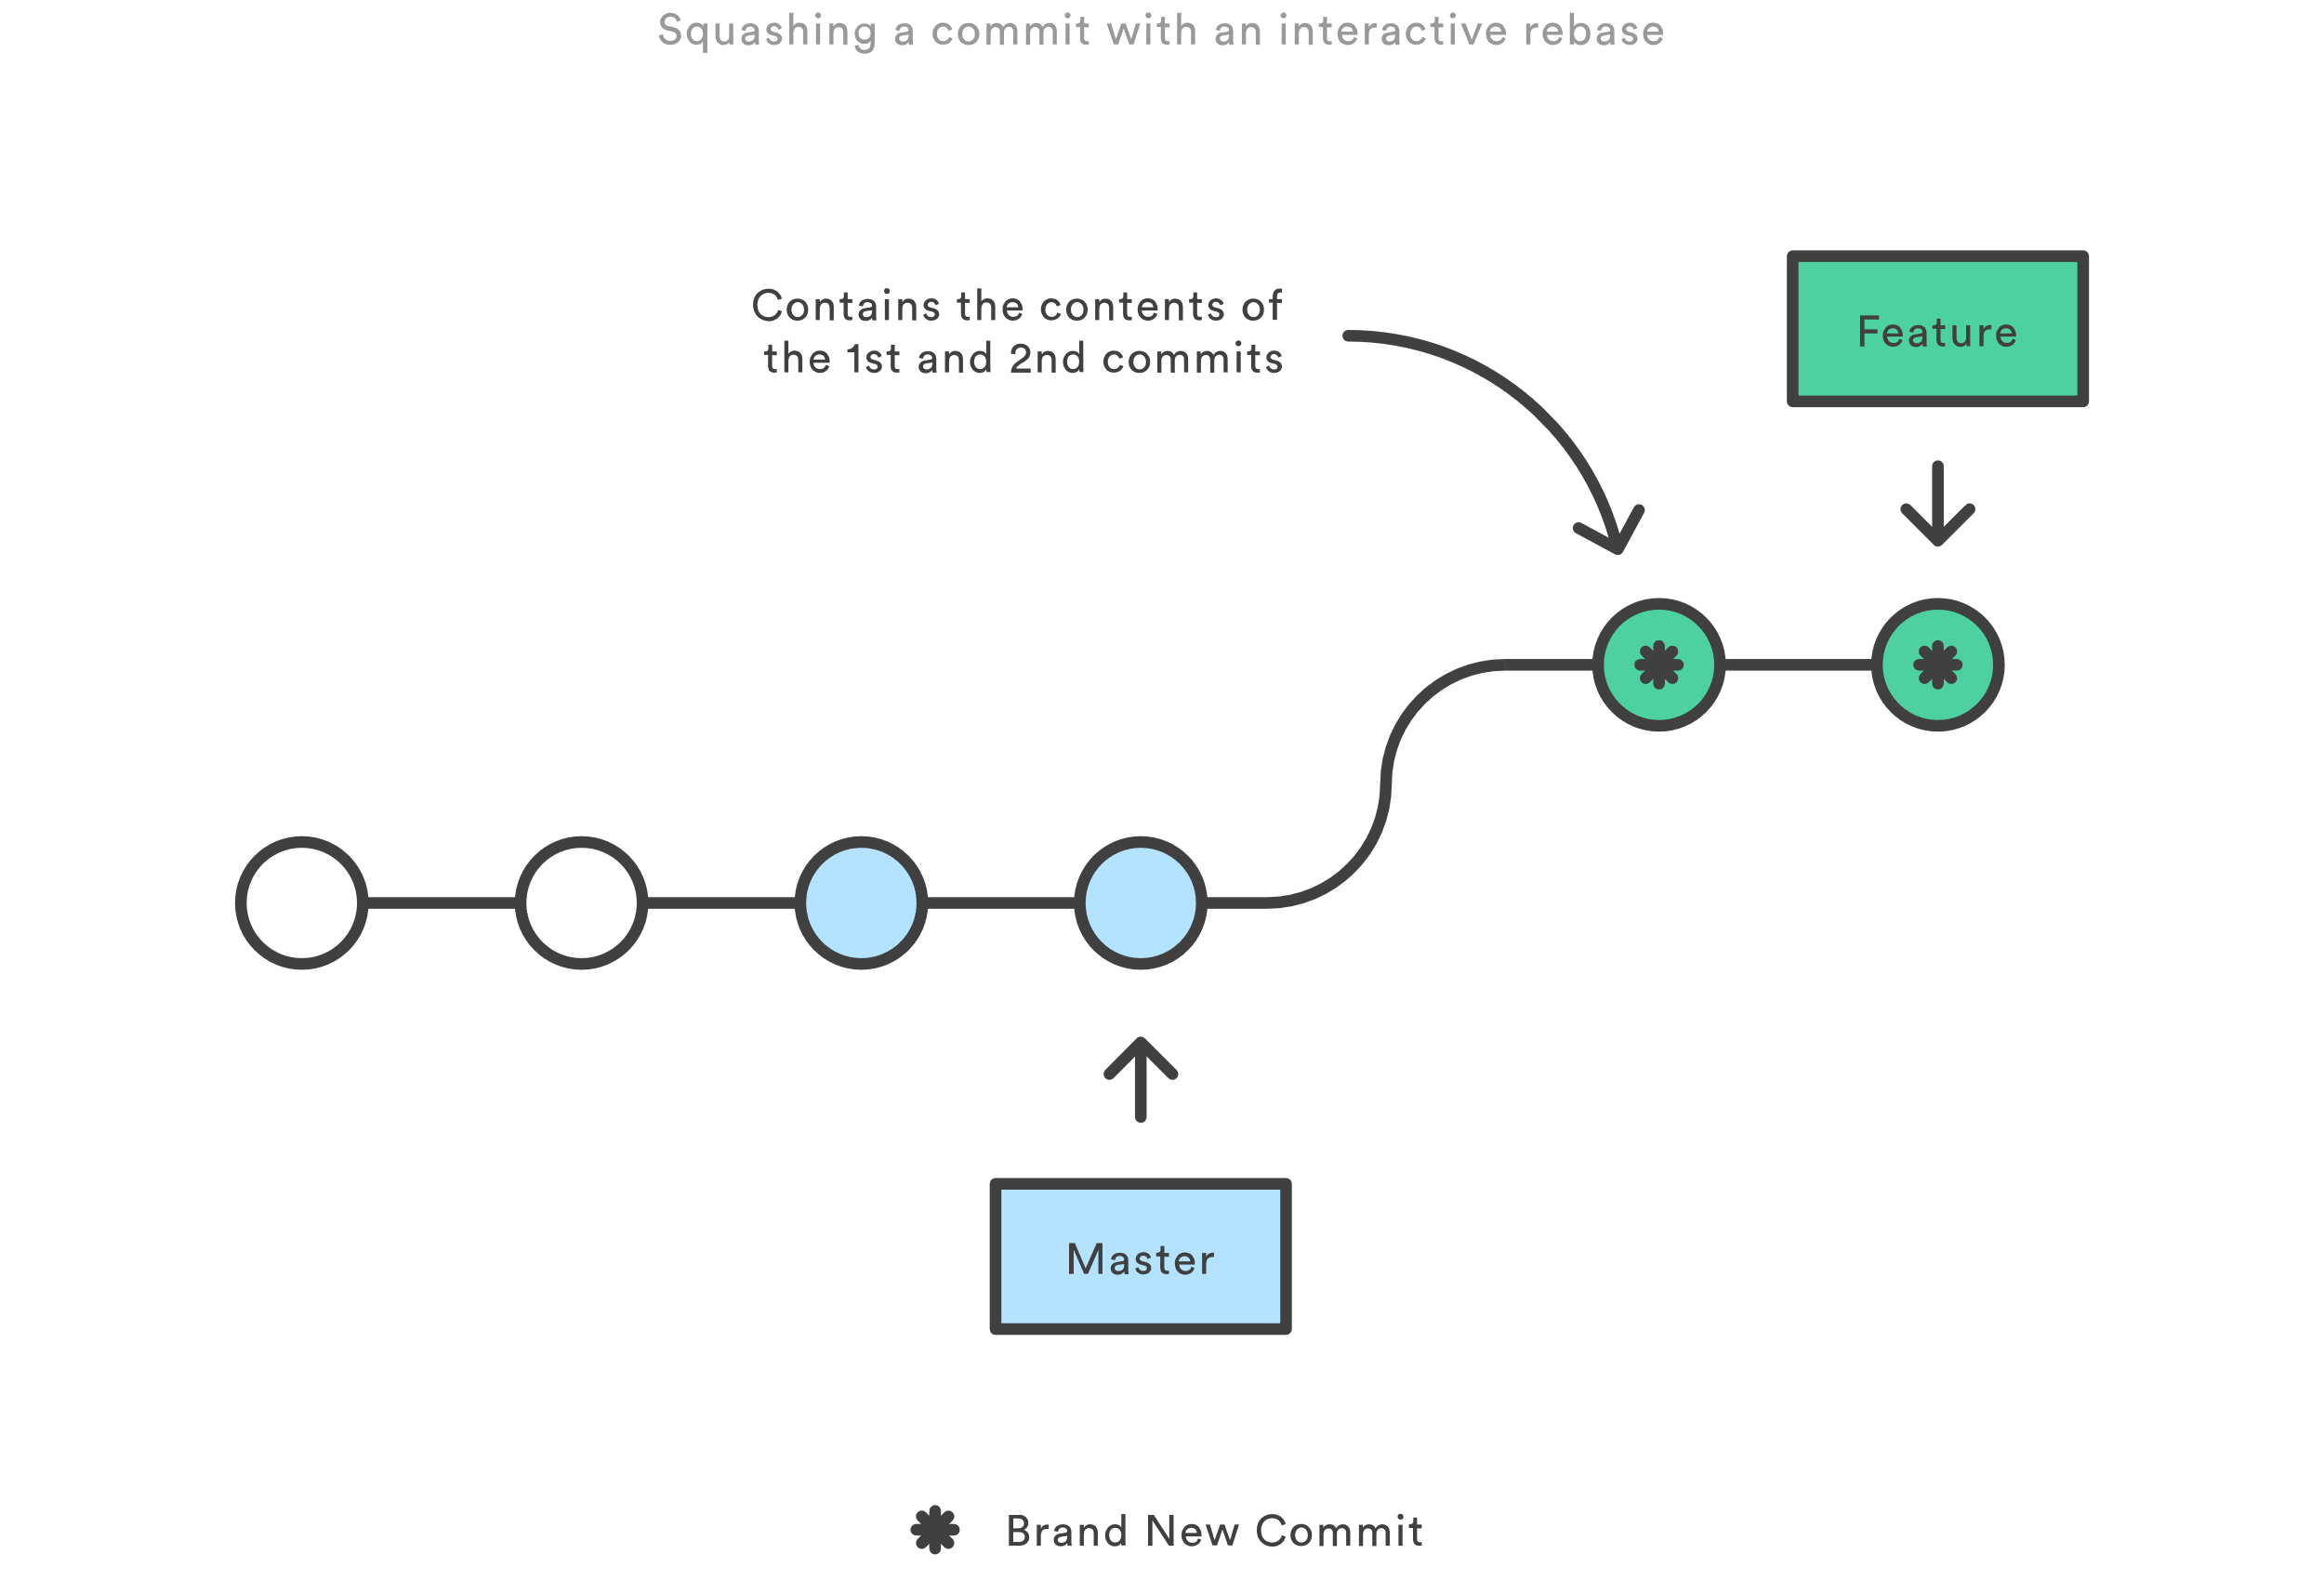
Rebase workflow (Cont.)

Slide 9
Rebase golden Rule
When rebasing, keep the golden rule in mind:
NEVER rebase a public branch over your branch
Rebasing gives you an opportunity to realign your history with team changes
Don’t make others have to realign around your own changes

Slide 10
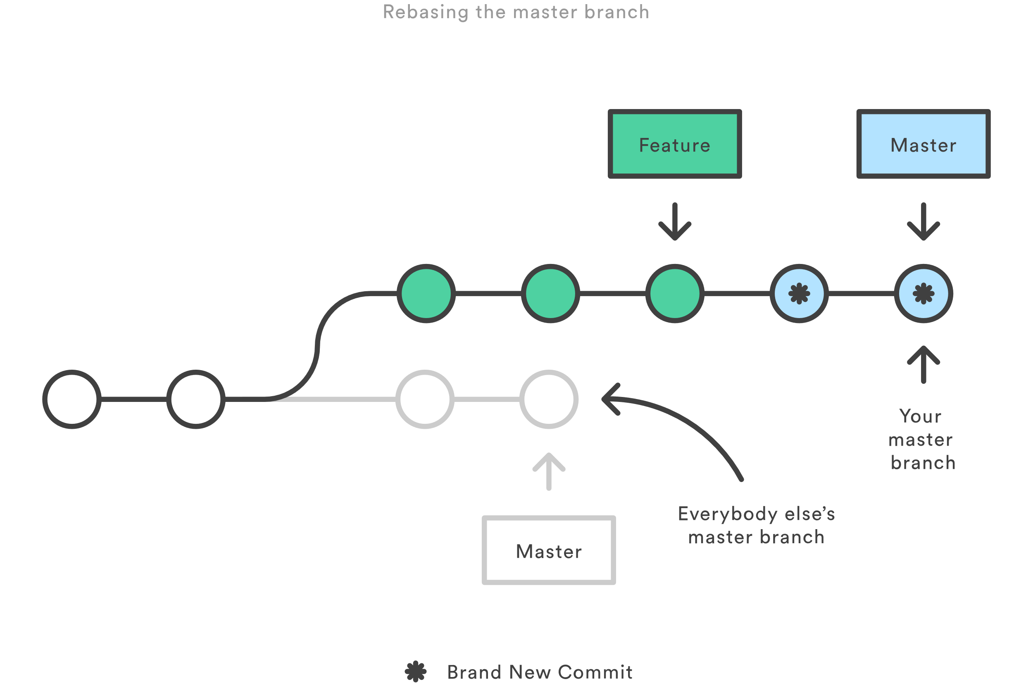
Rebase golden Rule - Illustrated

Slide 11
Rebase golden Rule - Illustrated

Slide 12
Leadup to lab 1
Rebase not only helps keep a clean tree, it can reduce clutter
Maintaining clean commit histories can be challenging
Consolidating commit messages and removing unnecessary commits
Alter history itself! (You can do some weird stuff with rebase!)
Important rebase terms:
Pick
Squash
Edit
Reword
Drop

Slide 13
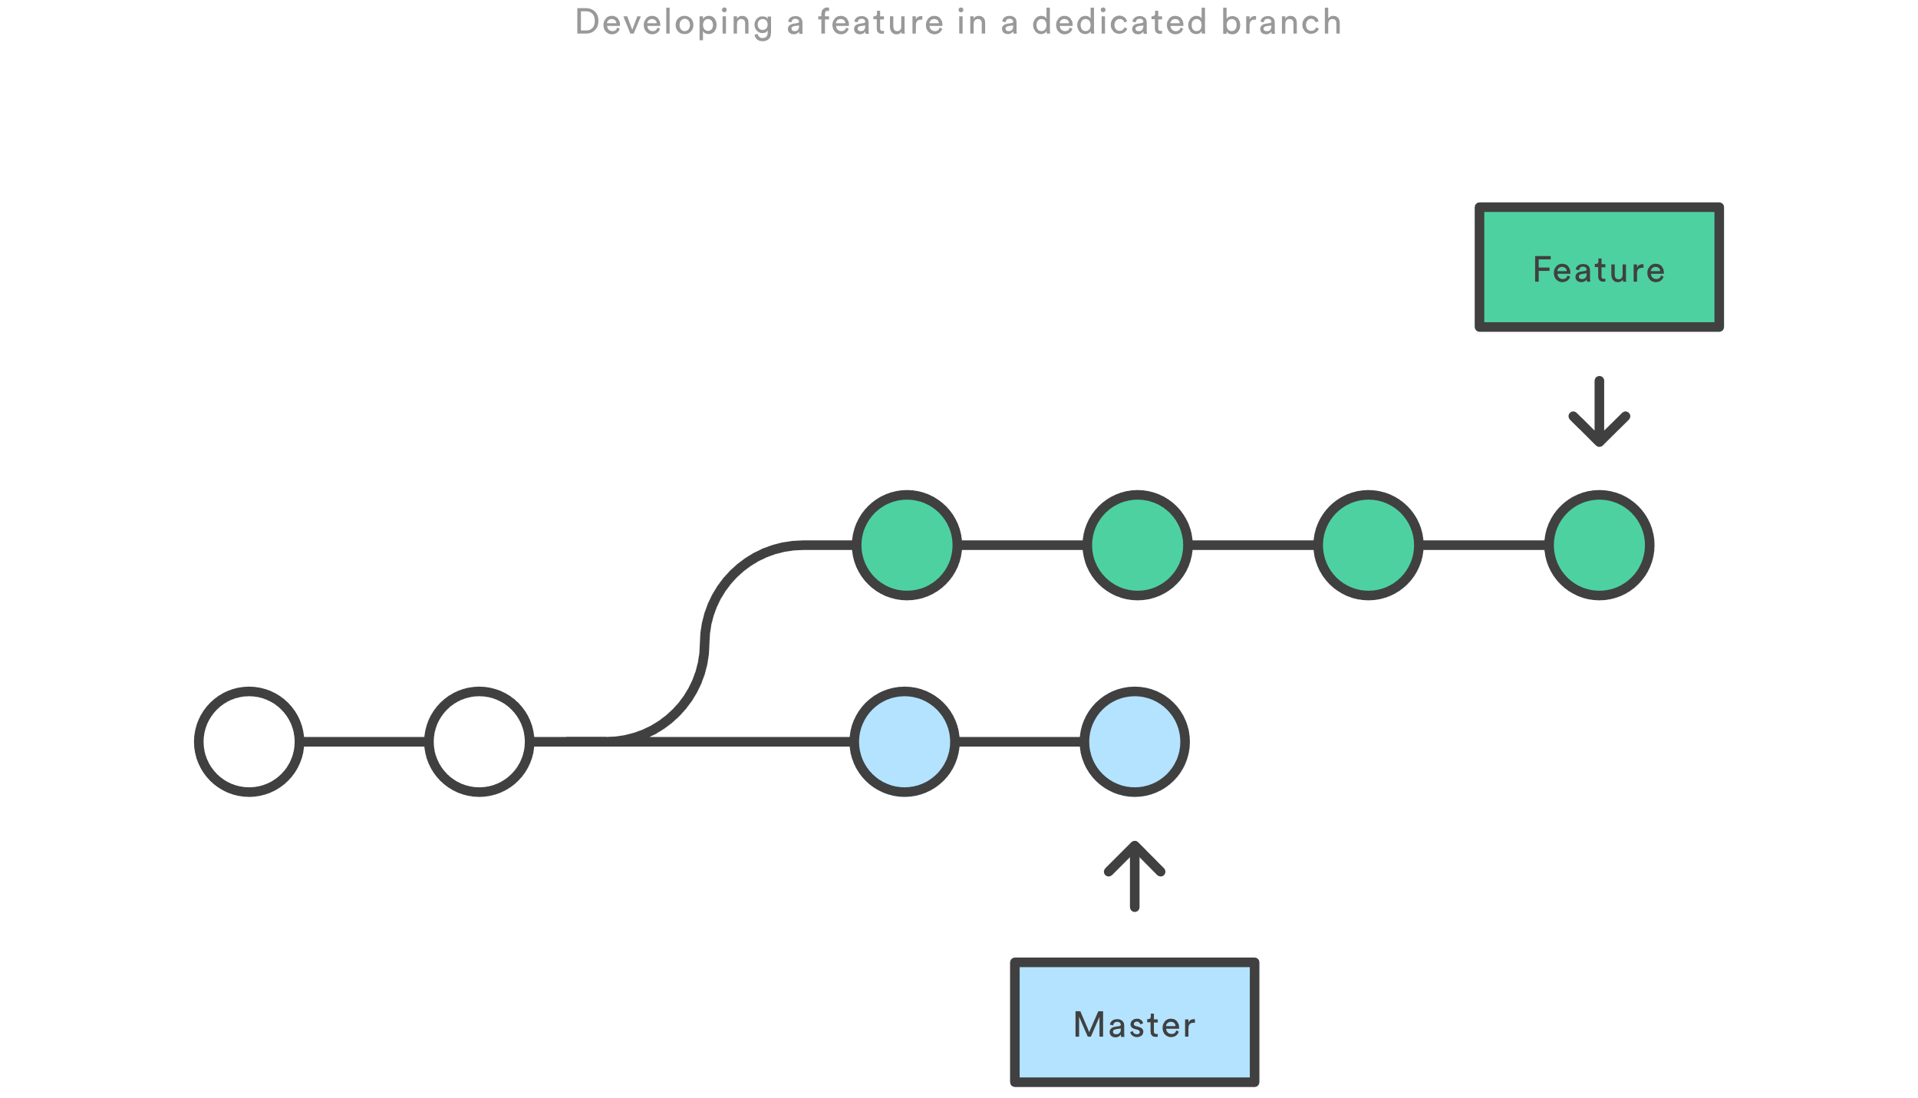
Lab 1 – Interactively rebasing

Slide 14
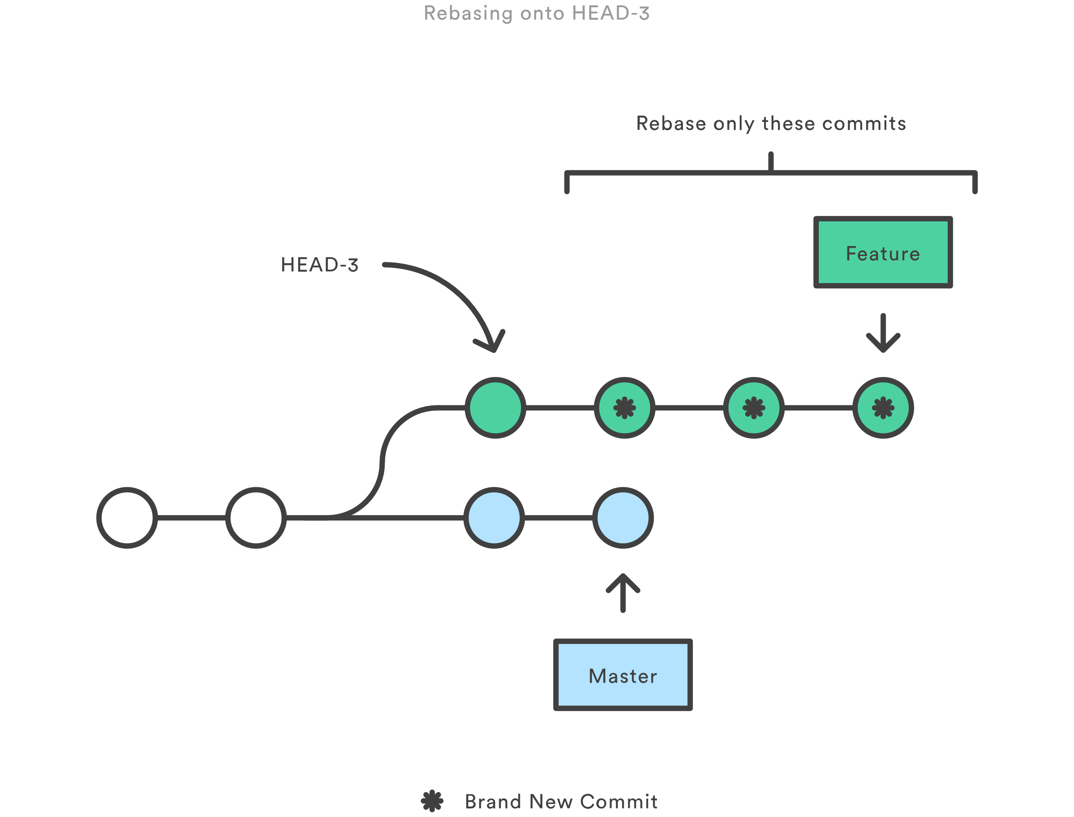
Lab 1 – Interactively rebasing

Slide 15
Lab 1 – Interactively rebasing
Create a new branch, called lab_1, and change to that branch
git branch lab_1
git checkout lab_1
Make a minor change, for our example we’re creating a temp file and updating it, and then commit that change with the commit message “commit 1”
echo “change 1” >> tmp.txt
git add tmp.txt
git commit –m “commit 1”

Slide 16
Lab 1 – Interactively rebasing (Cont.)
Do the same steps we did before, twice more, but incrementing the commit message by one each time (“commit 2”, “commit 3”)
echo “tmp” >> tmp.txt
git add tmp.txt
git commit –m “commit #”
Once finished, confirm that all commits and changes are in place and no files are pending commit (this prevents a rebase from occurring)
cat tmp.txt
git status
git log

Slide 17
Lab 1 – Interactively rebasing (Cont.)
We’re now ready to interactively rebase and clean up our commit history
git rebase –i HEAD~3
Squash commits 2 and 3 in the editor
Clean up the final commit message to now say “commit 1 with changes 1, 2, and 3”
git log
We now have a cleaner git history

Slide 18
Presentation End – open lab and questions
Can’t think of a question or need to leave before I can answer?
No worries! Send me an email – zach@zach-martin.com

